Slide 1
Lecture 16: Bagging and Random Forest

Slide 2
ANNOUNCEMENTS
Homework 5 (109) due tonight 11:59 pm
Homework 5 (209) due next Wednesday 11:59 pm, Nov 6
Homework 6 (109) to be released tomorrow morning
No 209 for homework 6

Slide 3


ANNOUNCEMENTS
Homework 7 individual
HW1
HW4
HW7
Without OH or ED forum

Slide 4

ANNOUNCEMENTS
After CS109B, STAT 139 …

Slide 5
Outline
Review of Decision Trees
Bagging
Out of Bag Error (OOB)
Variable Importance
Random Forests

Slide 6
Outline
Review of Decision Trees
Bagging
Out of Bag Error (OOB)
Variable Importance
Random Forests

Slide 7
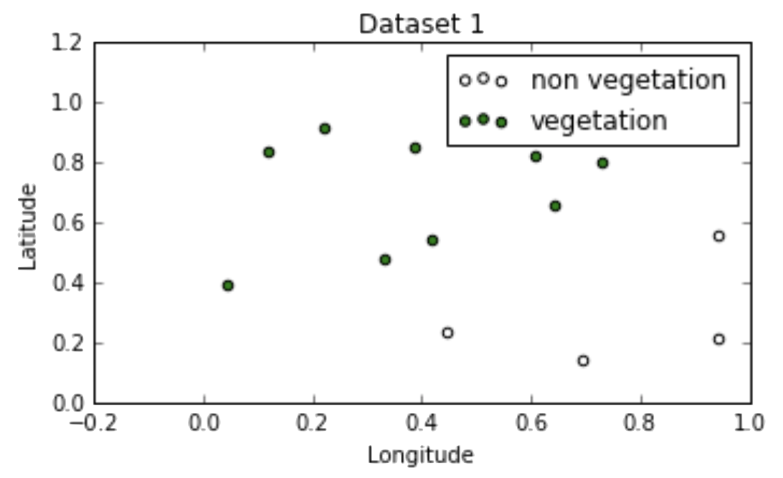
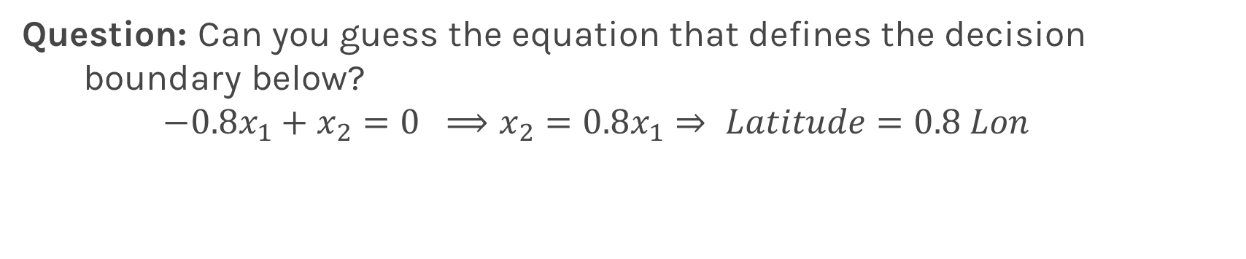
Geometry of Data
Question: Can you guess the equation that defines the decision boundary below?
$$−0.8x_{1}+x_{2}=0 ⟹x_{2}=0.8x_{1}⇒ Latitude=0.8 Lon$$

Slide 8
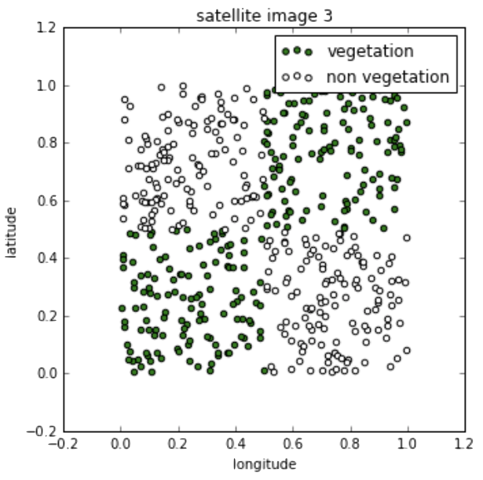
Geometry of Data
Complicate decision boundaries can not be explained with LogRegression.

Slide 9
Decision Trees
To learn a decision tree model, we take a greedy approach:
Start with an empty decision tree (undivided feature space)
Choose the ‘optimal’ predictor on which to split and choose the ‘optimal’ threshold value for splitting by applying a splitting criterion
Recurse on each new node until stopping condition is met
For classification, we label each region in the model with the label of the class to which the plurality of the points within the region belong.
For regression, we predict with the average of the output values of the training points contained in the region .

Slide 10
Splitting Criteria
The splitting criteria we’ve examined each minimize a loss function
For classification, purity of the regions is a good indicator the performance of the model. Entropy as a splitting criterial minimizes the cross-entropy (greedy).
For regression, we want to select a splitting criterion that promotes splits that improves the predictive accuracy of the model as measured by the MSE.

Slide 11
Stopping Conditions

Slide 12
Stopping Conditions
Common simple stopping conditions:
Don’t split a region if all instances in the region belong to the same class.
Don’t split a region if the number of instances in the sub-region will fall below pre-defined threshold (min_samples_leaf).
Don’t split a region if the total number of leaves in the tree will exceed pre-defined threshold.
The appropriate thresholds can be determined by evaluating the model on a held-out data set or, better yet, via cross-validation.

Slide 13
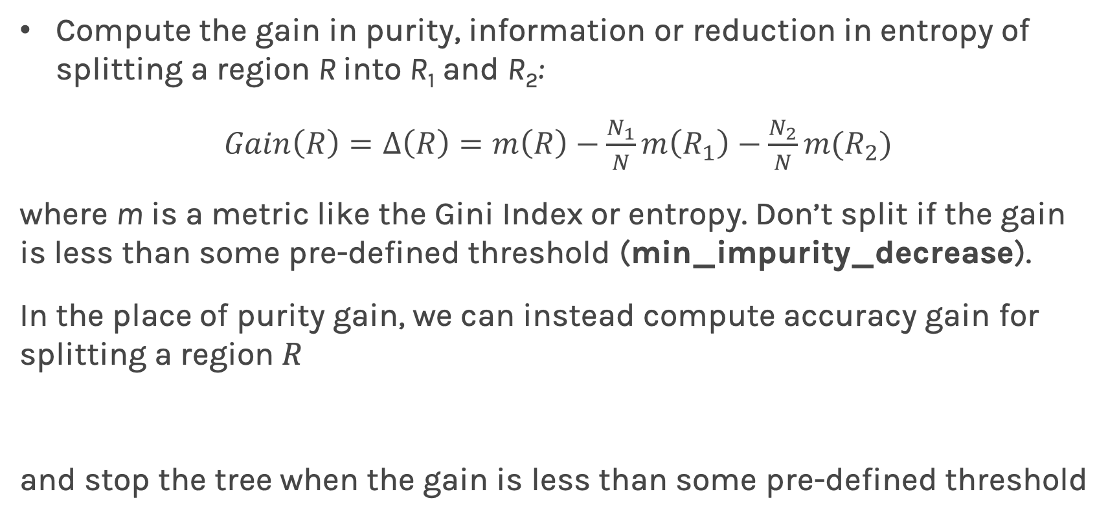
Stopping Conditions
Compute the gain in purity, information or reduction in entropy of splitting a region R into R₁ and R₂:
$Gain\left(R\right)=Δ\left(R\right)=m\left(R\right)−\frac{N_{1}}{N}m\left(R_{1}\right)−\frac{N_{2}}{N}m(R_{2})$
where m is a metric like the Gini Index or entropy. Don’t split if the gain is less than some pre-defined threshold (min_impurity_decrease).
In the place of purity gain, we can instead compute accuracy gain for splitting a region $R$
and stop the tree when the gain is less than some pre-defined threshold

Slide 14
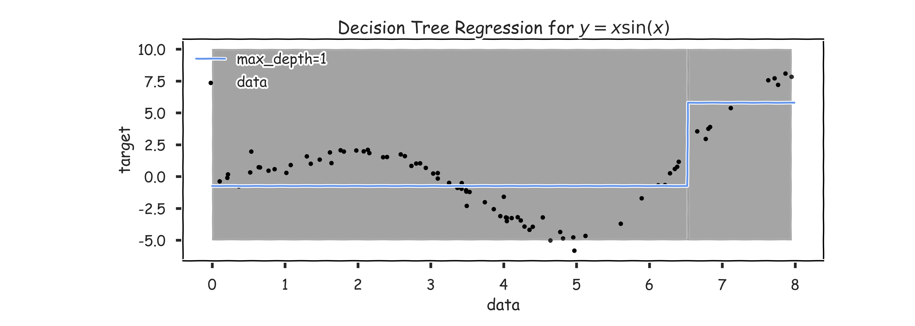
Regression Trees Prediction (grey scale represents MSE)

Slide 15
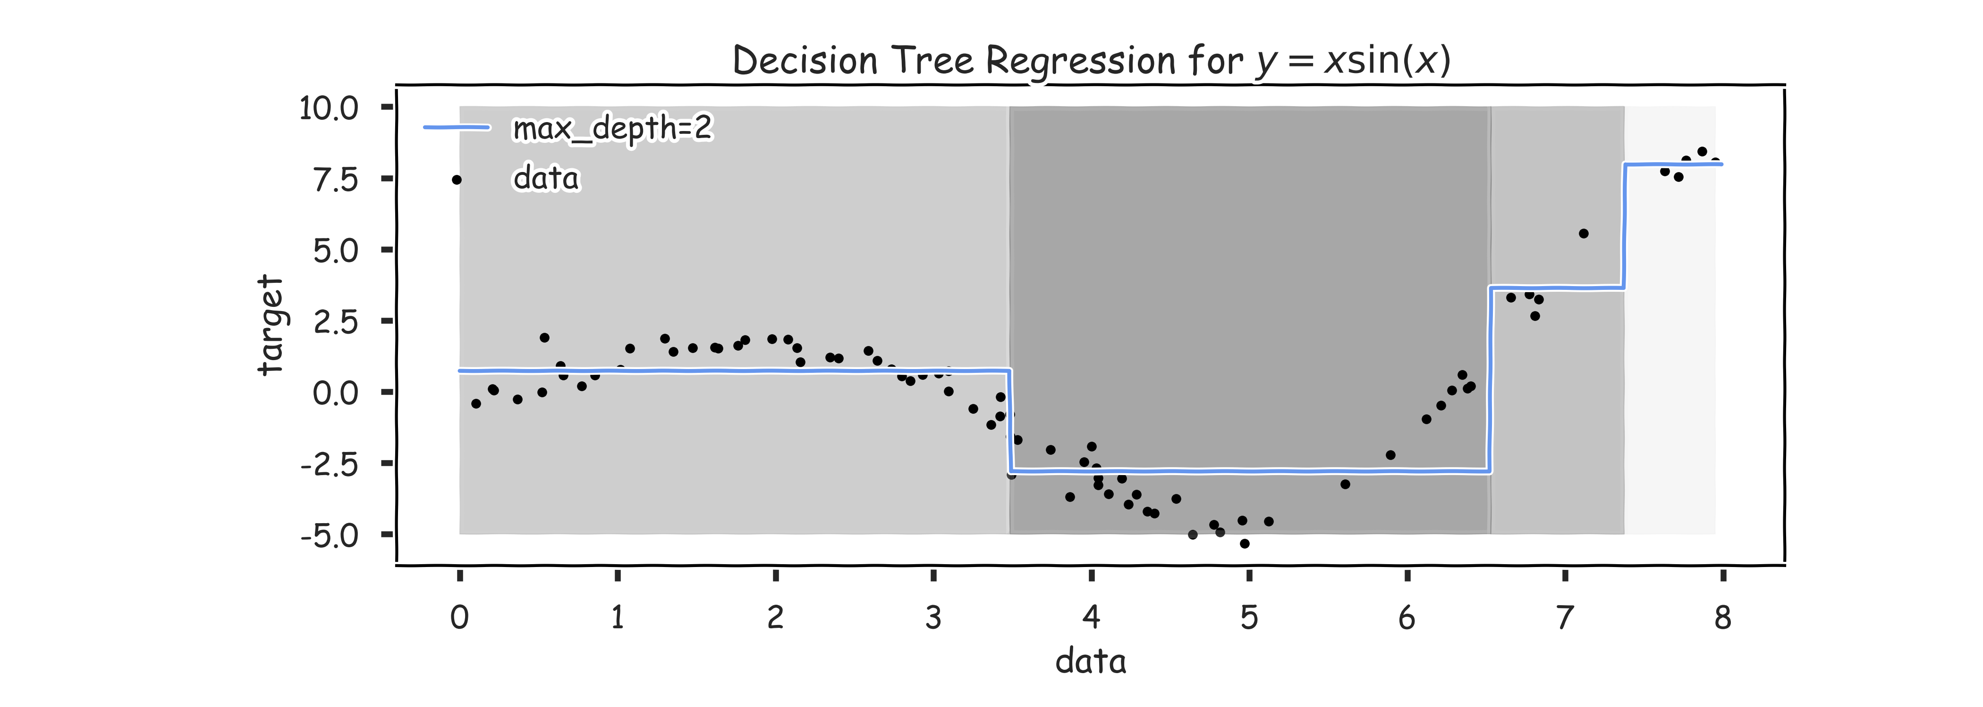
Regression Trees Prediction (grey scale represents MSE)

Slide 16
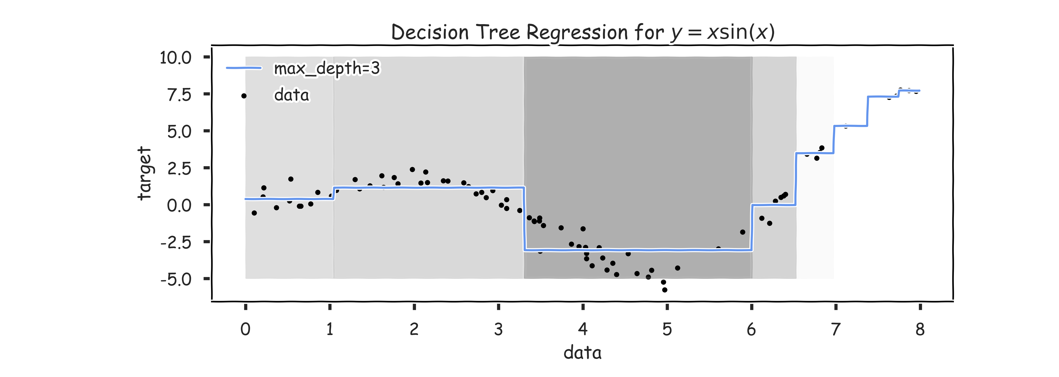
Regression Trees Prediction (grey scale represents MSE)

Slide 17
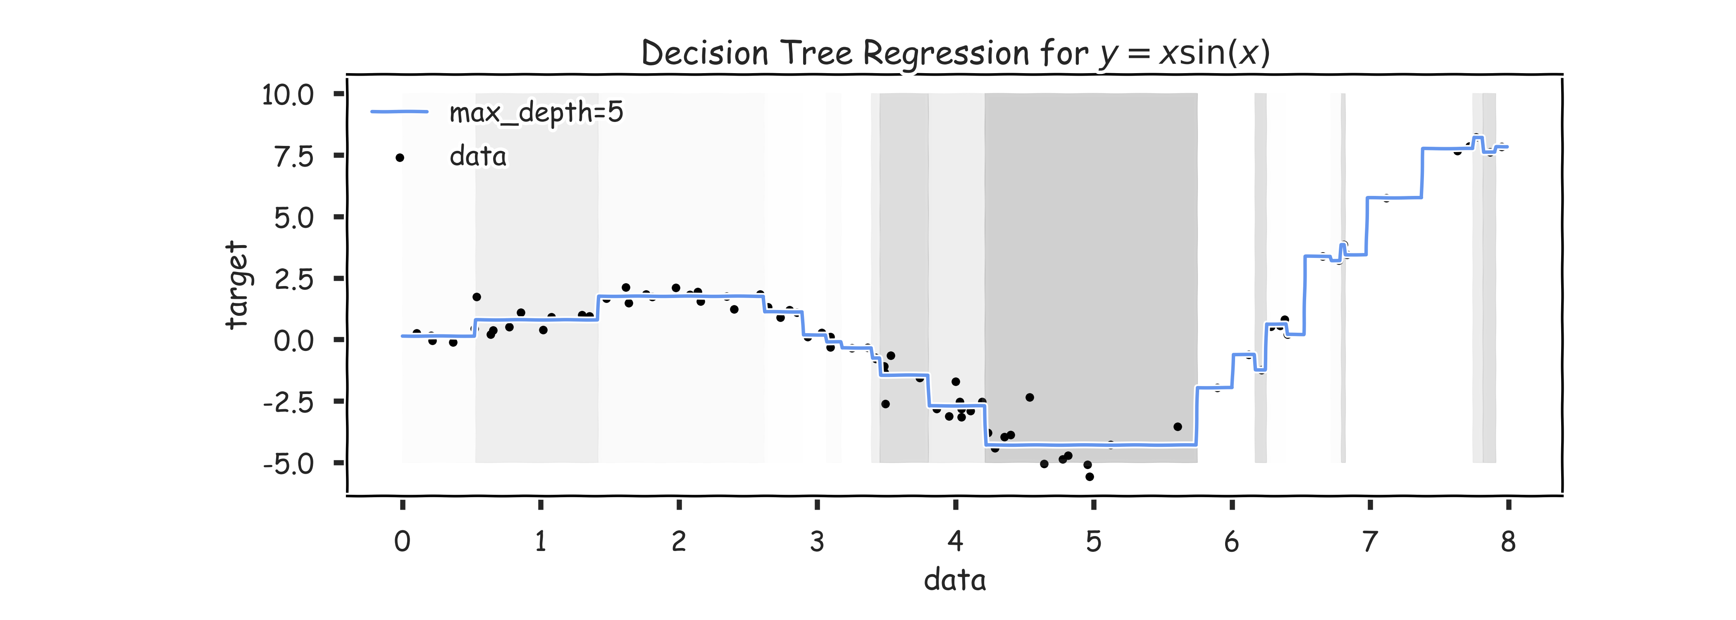
Regression Trees Prediction (grey scale represents MSE)

Slide 18
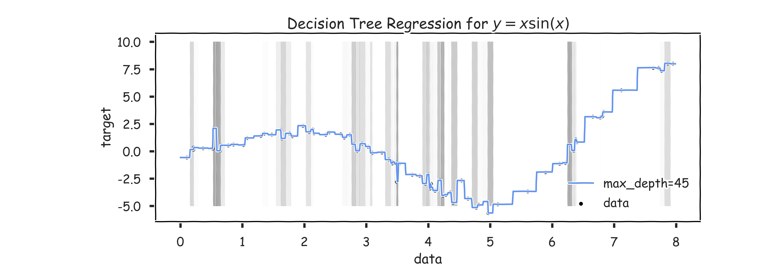
Regression Trees Prediction (grey scale represents MSE)

Slide 19
Overfitting
Same issues as with classification trees. Avoid overfitting by pruning or limiting the depth of the tree and using CV.

Slide 20
Bagging

Slide 21
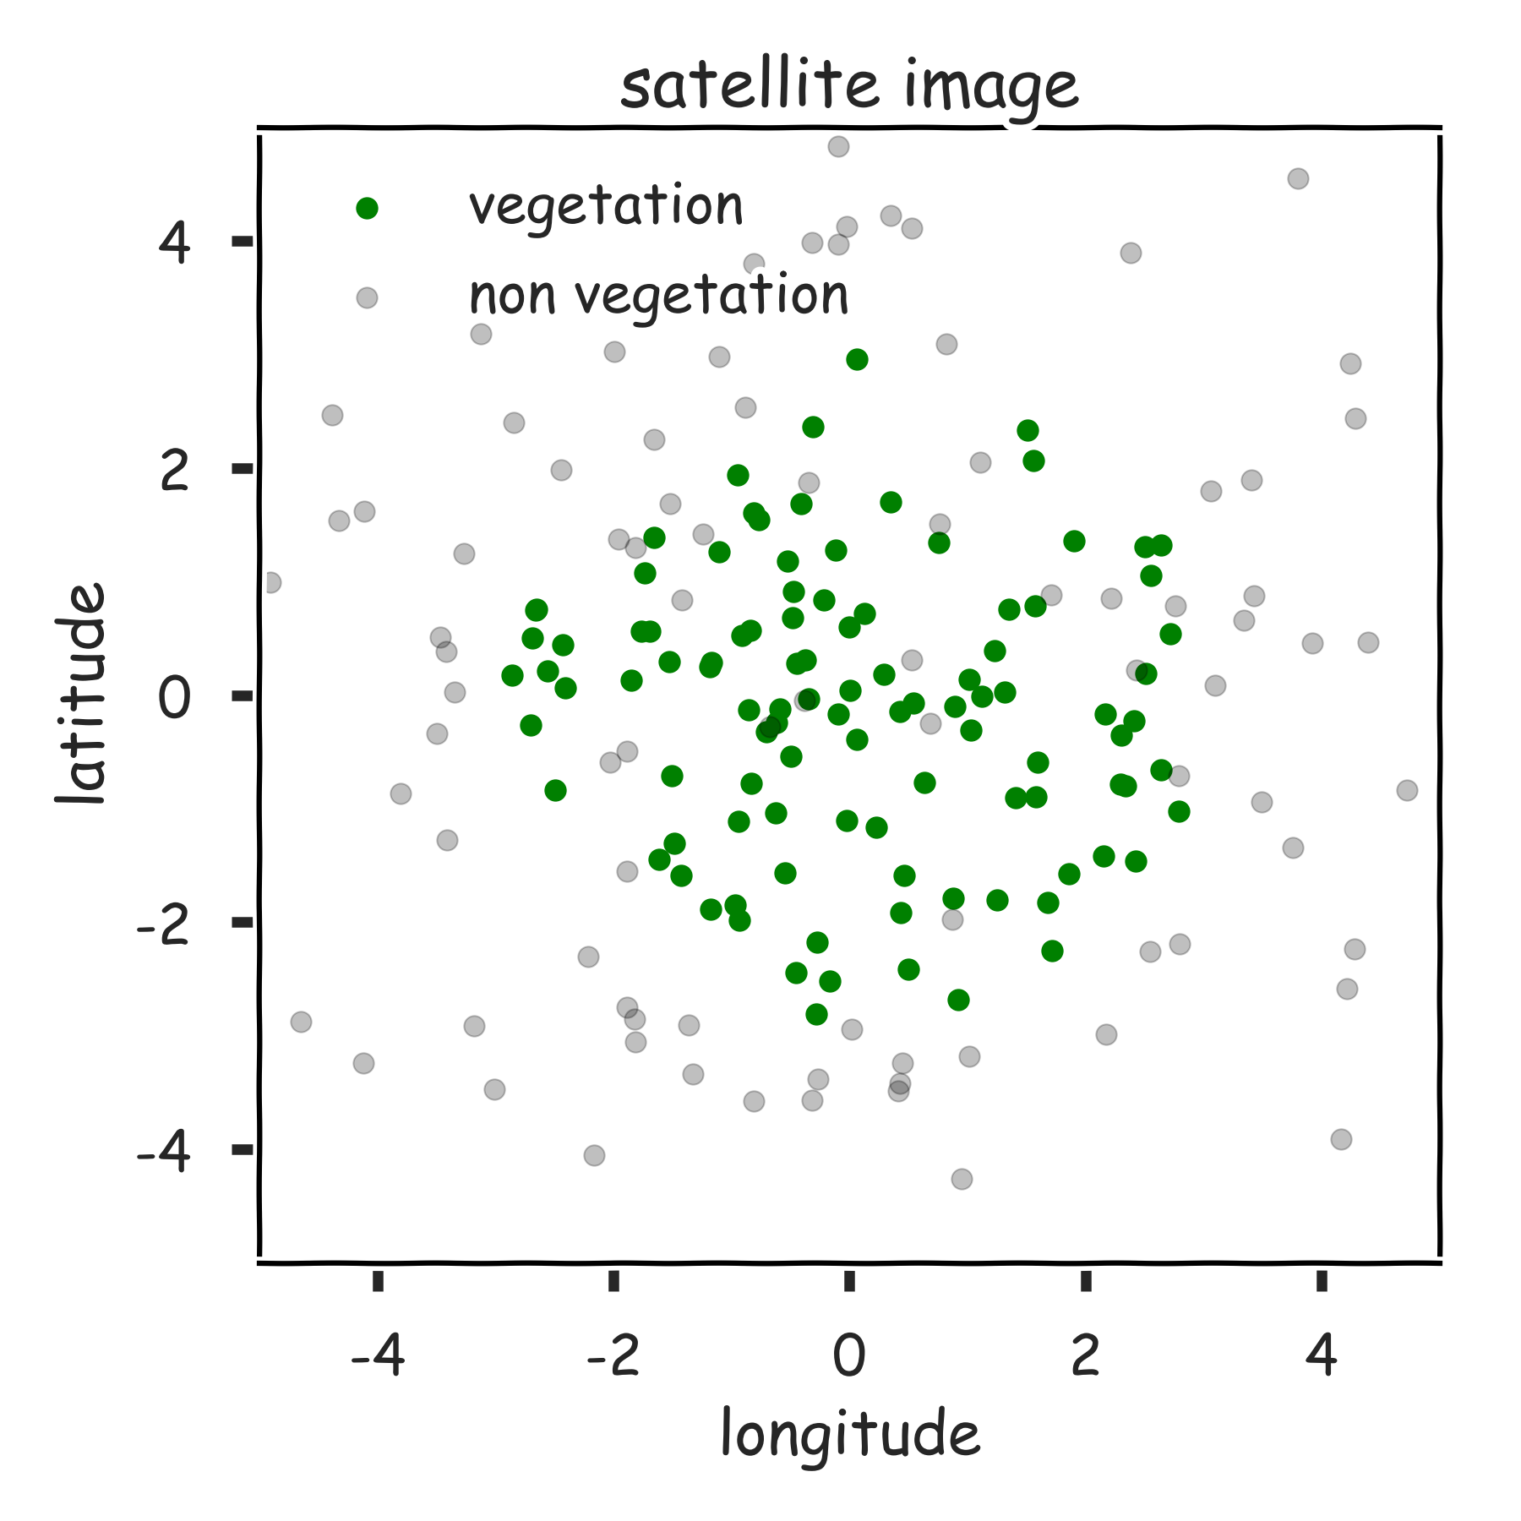
Reduce the variance

Slide 22
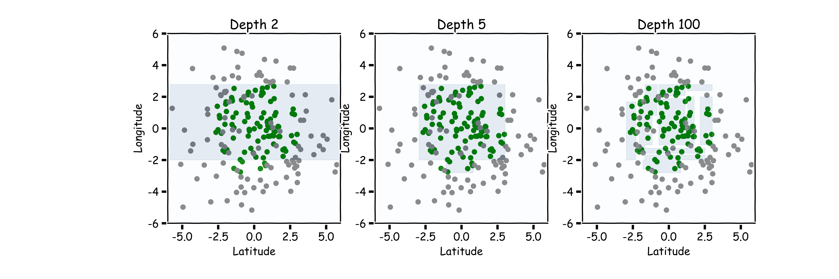
Hyper-parameters: Depth

Slide 23
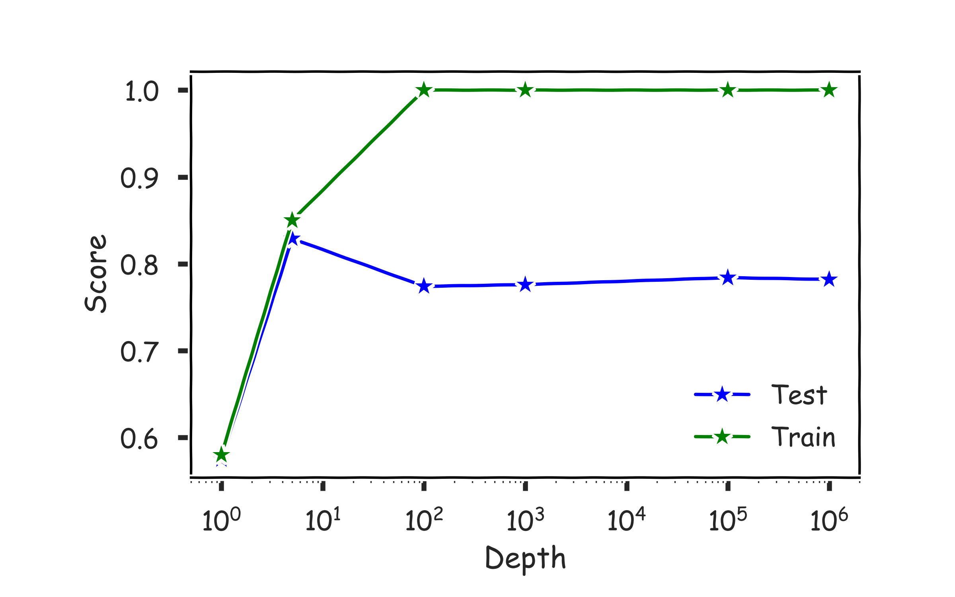
Hyper-parameters: Depth
Use train/validation or cross validation to estimate the best depth.
Val

Slide 24
Magic realism: Bootstrap

Slide 25
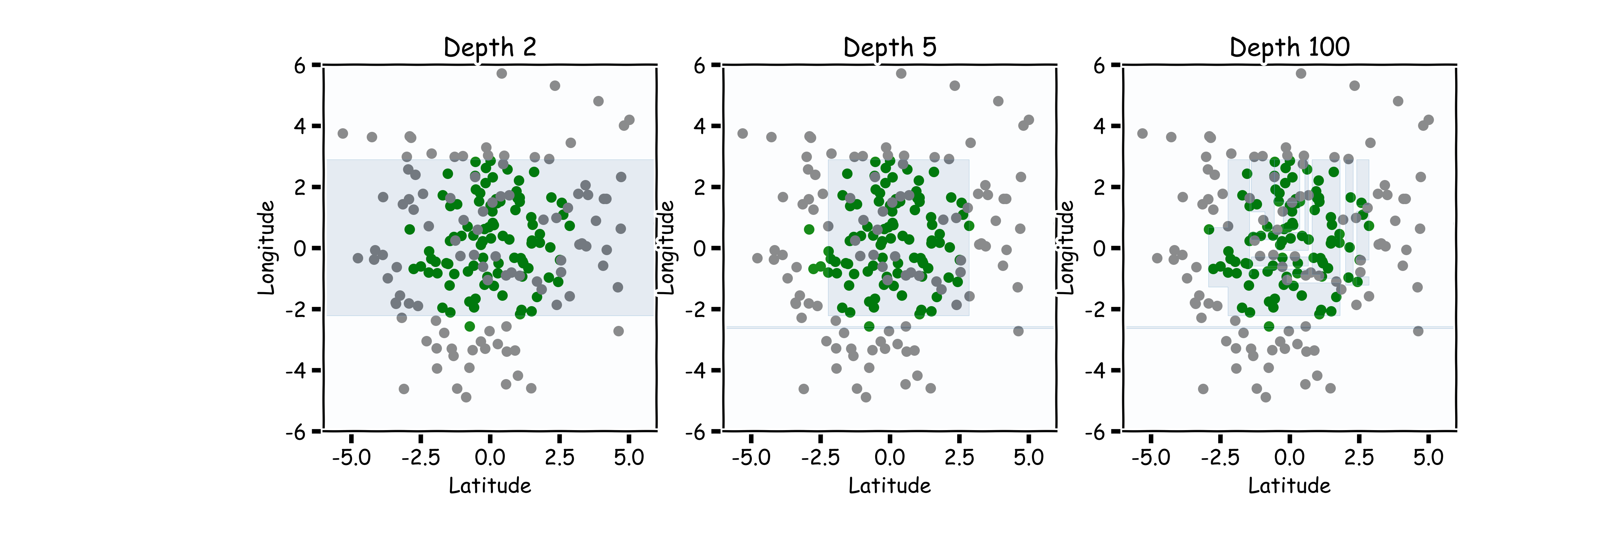
Magic realism: Bootstrap

Slide 26
Limitations of Decision Tree Models
Decision trees models are highly interpretable and fast to train, using our greedy learning algorithm.
However, in order to capture a complex decision boundary (or to approximate a complex function), we need to use a large tree (since each time we can only make axis aligned splits).
We’ve seen that large trees have high variance and are prone to overfitting.
For these reasons, in practice, decision tree models often underperforms when compared with other classification or regression methods.

Slide 27
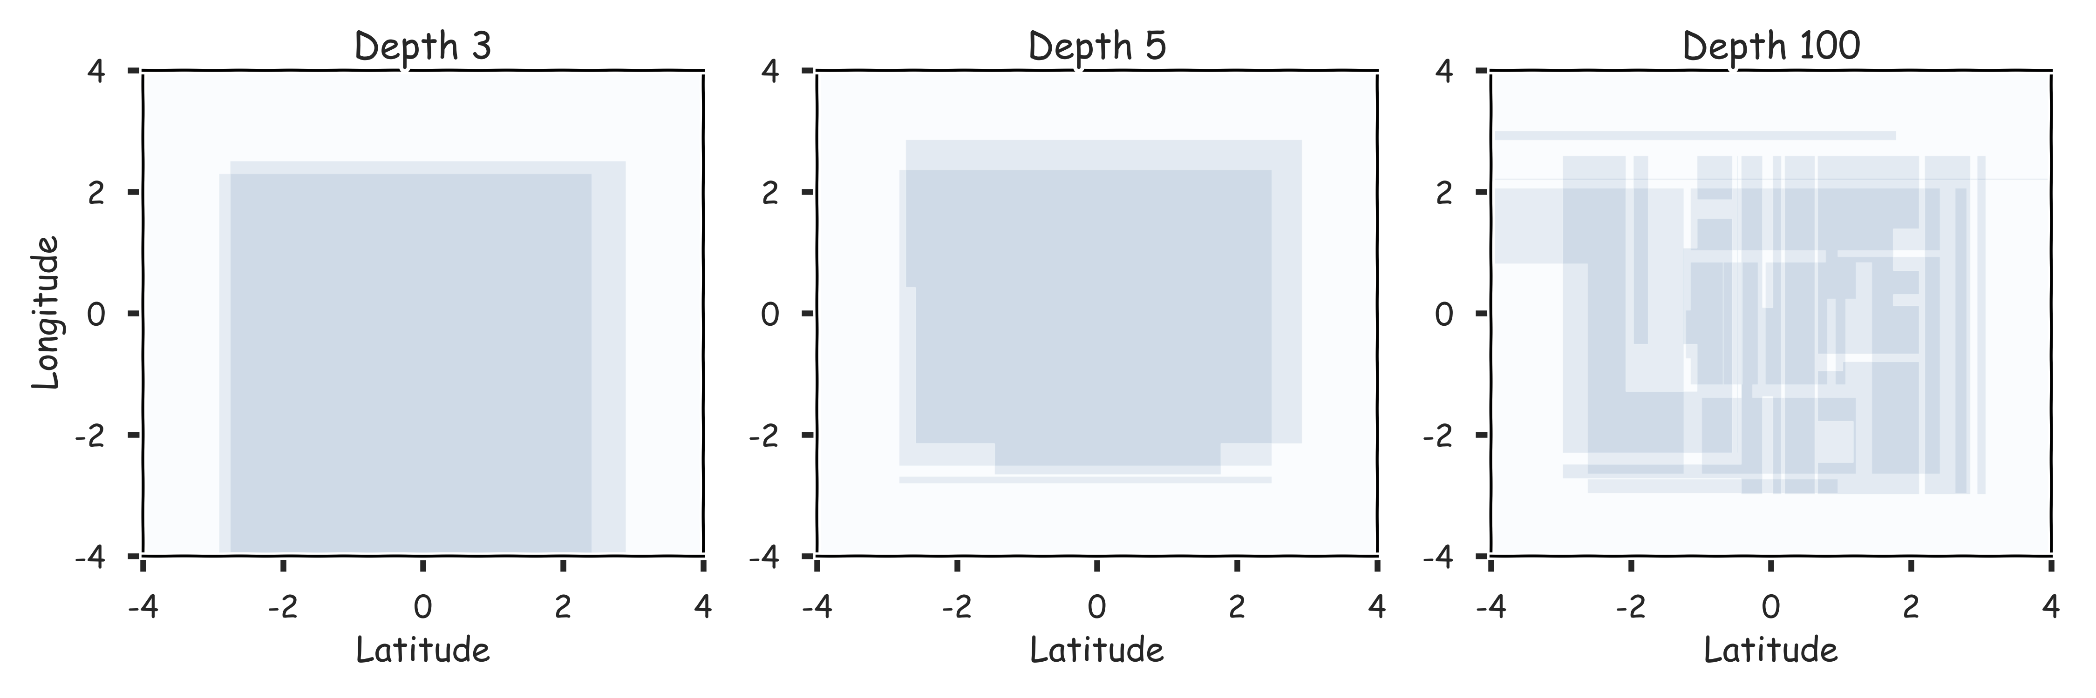
Combine them? 2 magic realisms

Slide 28
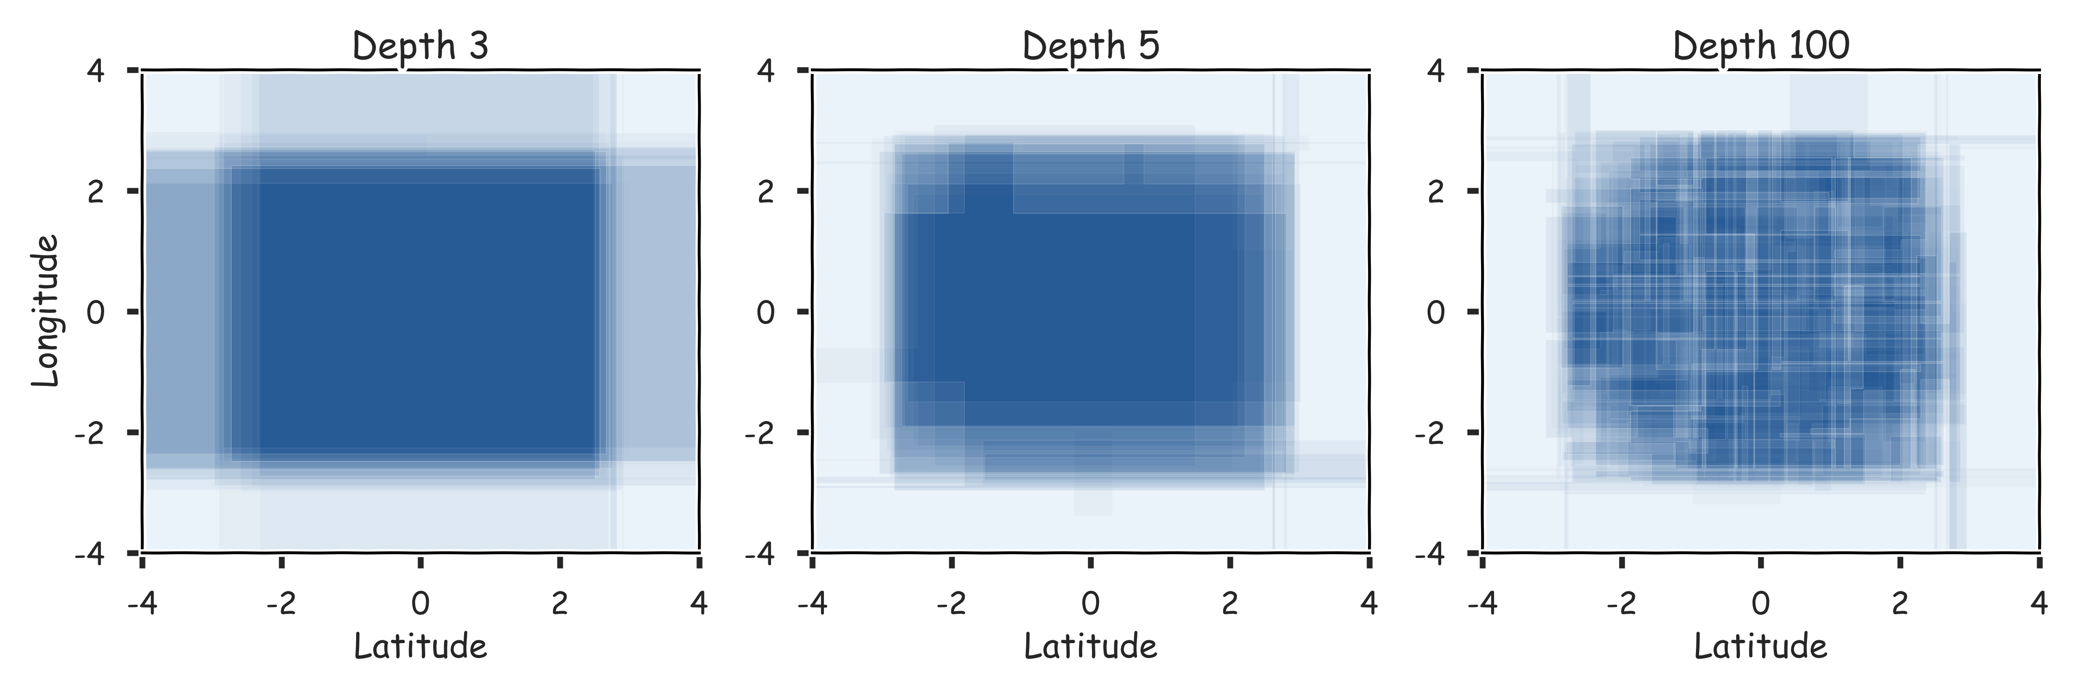
Combine them? 20 magic realisms

Slide 29
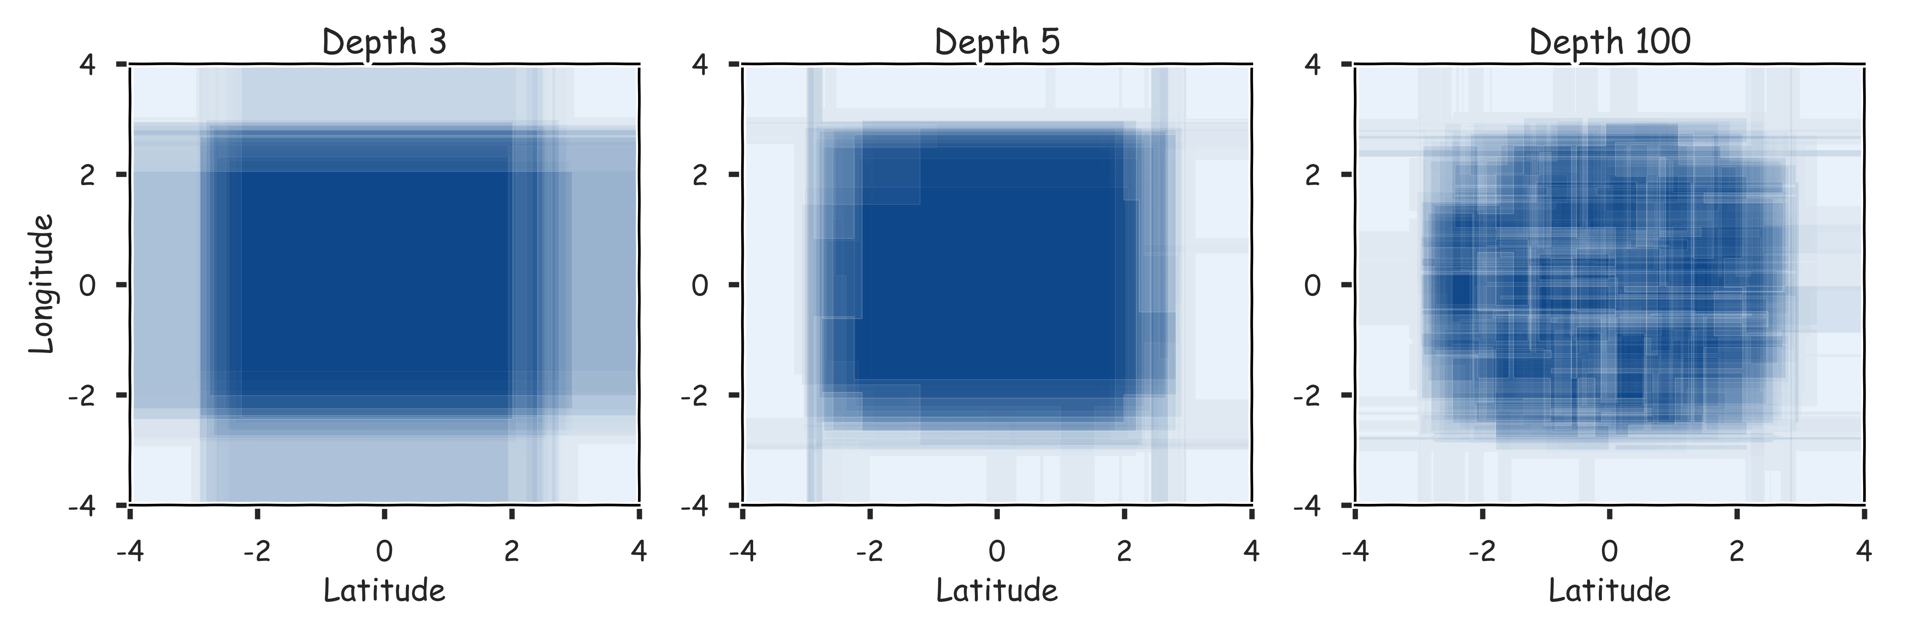
Combine them? 100 magic realisms

Slide 30
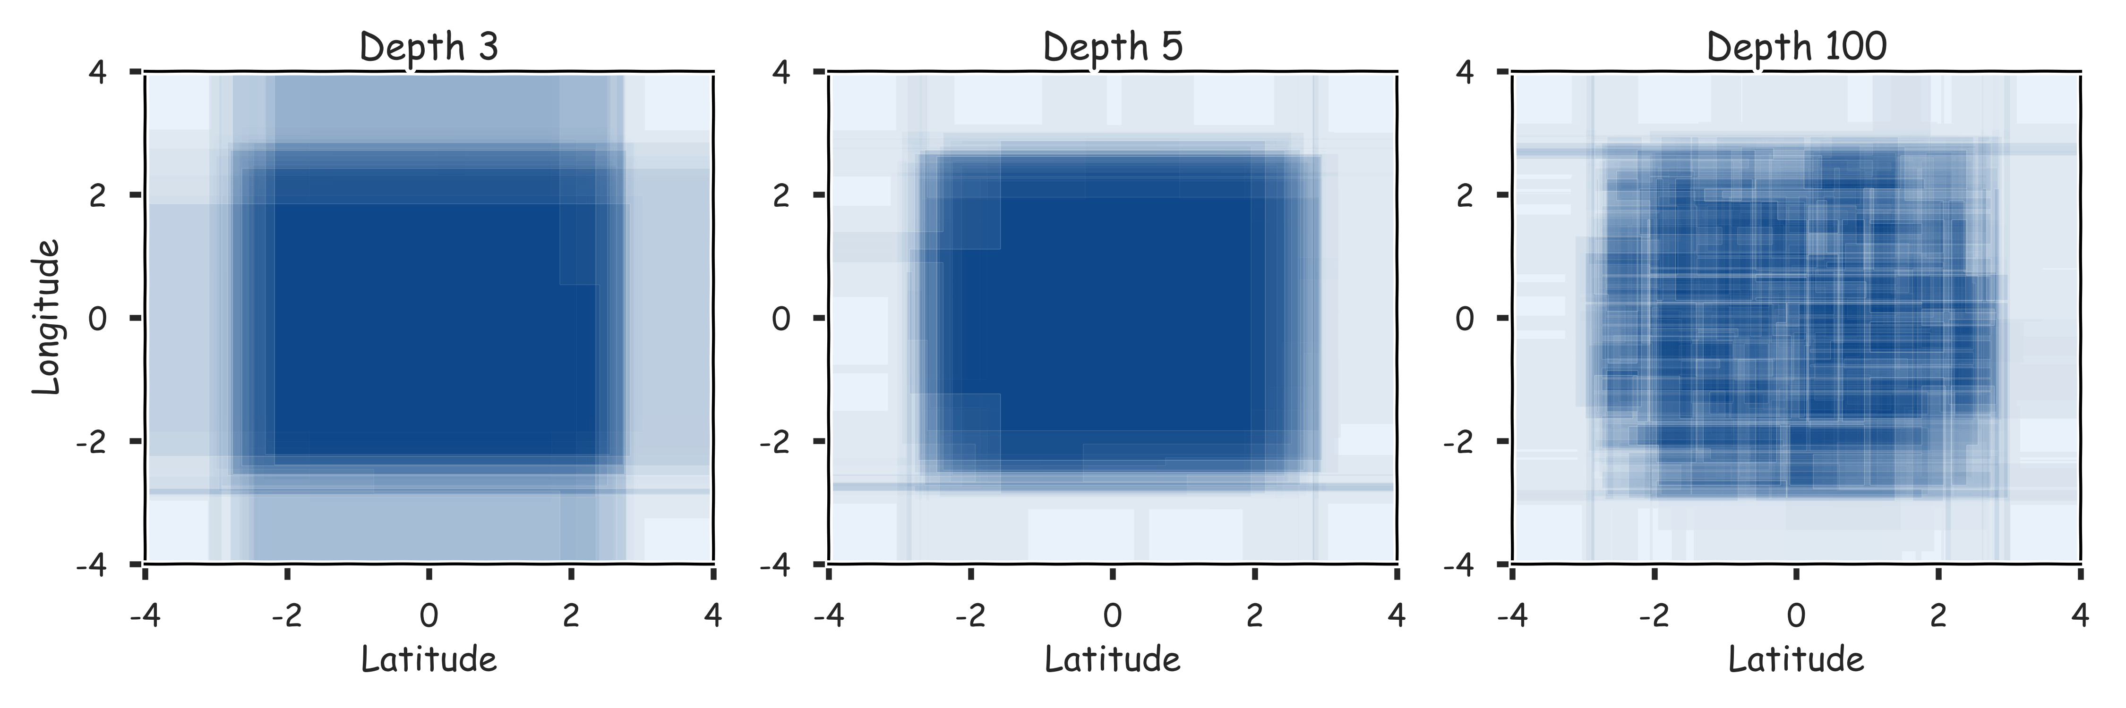
Combine them? 300 magic realisms

Slide 31
Bagging
One way to adjust for the high variance of the output of an experiment is to perform the experiment multiple times and then average the results.
The same idea can be applied to high variance models:
(Bootstrap)we generate multiple samples of training data, via bootstrapping. We train a full decision tree on each sample of data.
(Aggregate)for a given input, we output the averaged outputs of all the models for that input.
For classification, we return the class that is outputted by the plurality of the models. For regression we return the average of the outputs for each tree.
This method is called Bagging (Breiman, 1996), short for, of course, Bootstrap Aggregating.

Slide 32
Bagging
Note that bagging enjoys the benefits of:
High expressiveness - by using full trees each model is able to approximate complex functions and decision boundaries.
Low variance - averaging the prediction of all the models reduces the variance in the final prediction, assuming that we choose a sufficiently large number of trees.

Slide 33
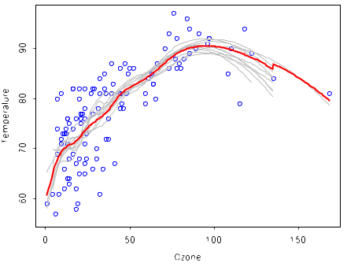
Bagging (regression)

Slide 34
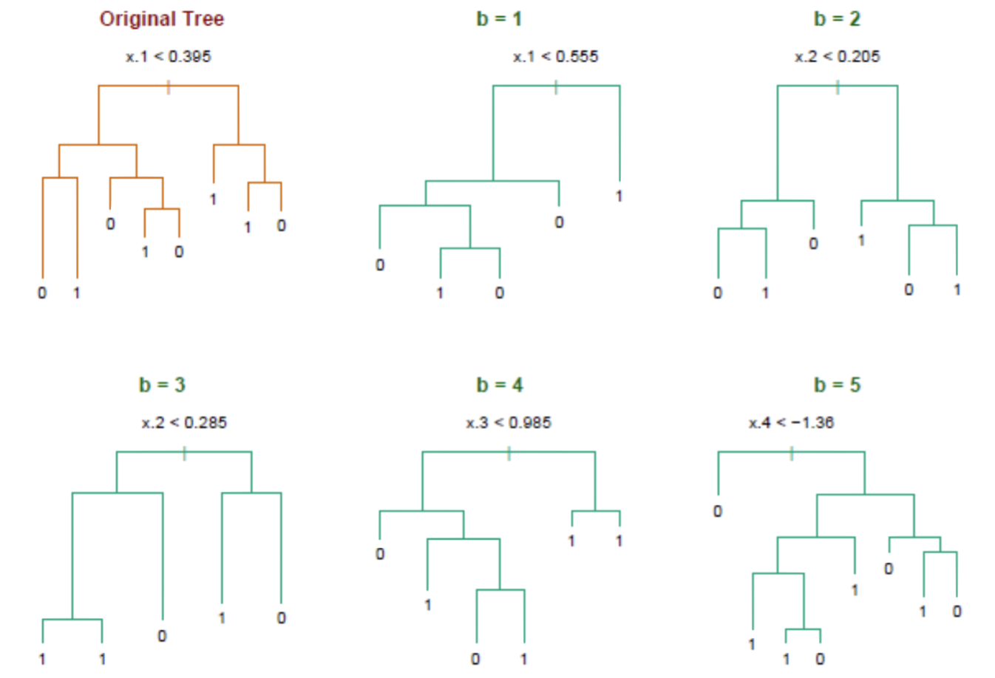
Bagging (classification)

Slide 35
Bagging
Question: Do you see any problems?
Still some overfitting if the trees are too large.
If trees are too shallow it can still underfits.
Interpretability:
The major drawback of bagging (and other ensemble methods that we will study) is that the averaged model is no longer easily interpretable - i.e. one can no longer trace the ‘logic’ of an output through a series of decisions based on predictor values!

Slide 36
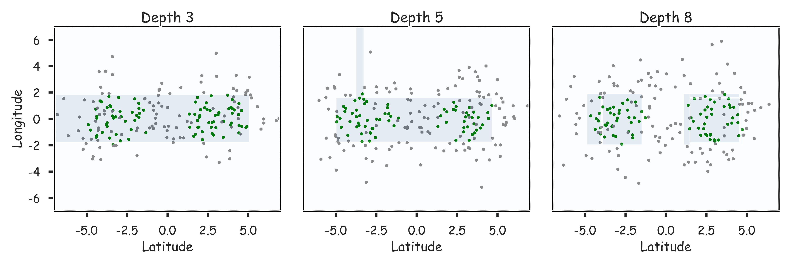
Case of underfitting

Slide 37
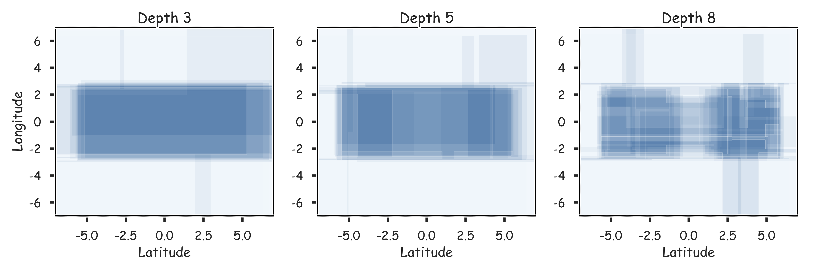
Case of underfitting

Slide 38
Bagging
Question: Do you see any problems?
Still some overfitting if the trees are too large
If trees are too shallow it can still underfits.
Cross Validations

Slide 39
Out-of-Bag Error

Slide 40
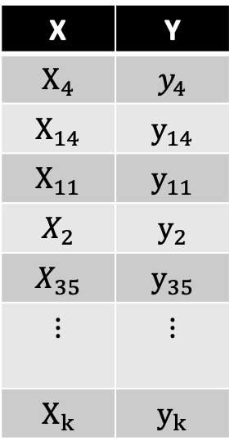
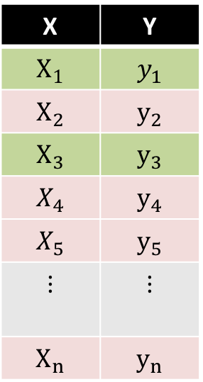
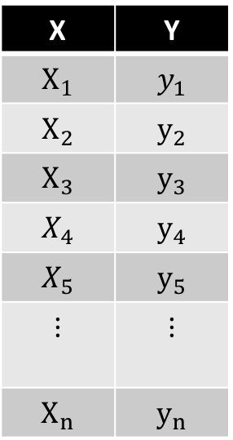
Bagging
Original Data
Bootstrap Sample 1
Decision Tree 1
Used and unused data
X | Y
$$X_{1}$$ | $$y_{1}$$
$$X_{2}$$ | $$y_{2}$$
$$X_{3}$$ | $$y_{3}$$
$$X_{4}$$ | $$y_{4}$$
$$X_{5}$$ | $$y_{5}$$
$$⋮$$ | $$⋮$$
$$X_{n}$$ | $$y_{n}$$
X | Y
$$X_{4}$$ | $$y_{4}$$
$$X_{14}$$ | $$y_{14}$$
$$X_{11}$$ | $$y_{11}$$
$$X_{2}$$ | $$y_{2}$$
$$X_{35}$$ | $$y_{35}$$
$$⋮$$ | $$⋮$$
$$X_{k}$$ | $$y_{k}$$
X | Y
$$X_{1}$$ | $$y_{1}$$
$$X_{2}$$ | $$y_{2}$$
$$X_{3}$$ | $$y_{3}$$
$$X_{4}$$ | $$y_{4}$$
$$X_{5}$$ | $$y_{5}$$
$$⋮$$ | $$⋮$$
$$X_{n}$$ | $$y_{n}$$

Slide 41
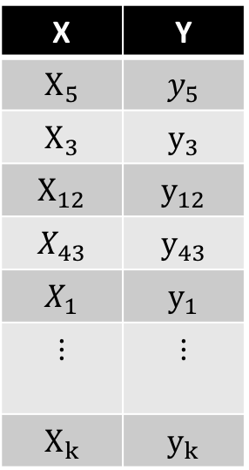
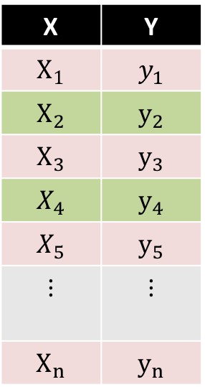
Bagging
Original Data
Bootstrap Sample 2
Decision Tree 2
Used and unused data
X | Y
$$X_{1}$$ | $$y_{1}$$
$$X_{2}$$ | $$y_{2}$$
$$X_{3}$$ | $$y_{3}$$
$$X_{4}$$ | $$y_{4}$$
$$X_{5}$$ | $$y_{5}$$
$$⋮$$ | $$⋮$$
$$X_{n}$$ | $$y_{n}$$
X | Y
$$X_{5}$$ | $$y_{5}$$
$$X_{3}$$ | $$y_{3}$$
$$X_{12}$$ | $$y_{12}$$
$$X_{43}$$ | $$y_{43}$$
$$X_{1}$$ | $$y_{1}$$
$$⋮$$ | $$⋮$$
$$X_{k}$$ | $$y_{k}$$
X | Y
$$X_{1}$$ | $$y_{1}$$
$$X_{2}$$ | $$y_{2}$$
$$X_{3}$$ | $$y_{3}$$
$$X_{4}$$ | $$y_{4}$$
$$X_{5}$$ | $$y_{5}$$
$$⋮$$ | $$⋮$$
$$X_{n}$$ | $$y_{n}$$

Slide 42

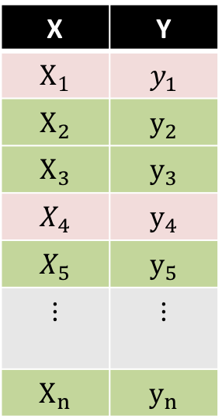
Bagging
Original Data
Bootstrap Sample 3
Decision Tree 3
Used and unused data
X | Y
$$X_{1}$$ | $$y_{1}$$
$$X_{2}$$ | $$y_{2}$$
$$X_{3}$$ | $$y_{3}$$
$$X_{4}$$ | $$y_{4}$$
$$X_{5}$$ | $$y_{5}$$
$$⋮$$ | $$⋮$$
$$X_{n}$$ | $$y_{n}$$
X | Y
$$X_{9}$$ | $$y_{9}$$
$$X_{4}$$ | $$y_{4}$$
$$X_{1}$$ | $$y_{1}$$
$$X_{1}$$ | $$y_{1}$$
$$X_{65}$$ | $$y_{65}$$
$$⋮$$ | $$⋮$$
$$X_{k}$$ | $$y_{k}$$
X | Y
$$X_{1}$$ | $$y_{1}$$
$$X_{2}$$ | $$y_{2}$$
$$X_{3}$$ | $$y_{3}$$
$$X_{4}$$ | $$y_{4}$$
$$X_{5}$$ | $$y_{5}$$
$$⋮$$ | $$⋮$$
$$X_{n}$$ | $$y_{n}$$

Slide 43
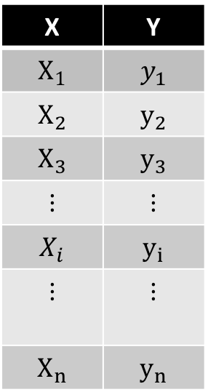
Point-wise out-of-bag error
X | Y
$$X_{1}$$ | $$y_{1}$$
$$X_{2}$$ | $$y_{2}$$
$$X_{3}$$ | $$y_{3}$$
$$⋮$$ | $$⋮$$
$$X_{i}$$ | $$y_{i}$$
$$⋮$$ | $$⋮$$
$$X_{n}$$ | $$y_{n}$$

Slide 44
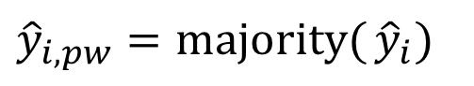
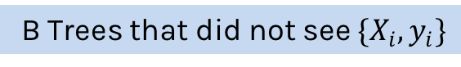
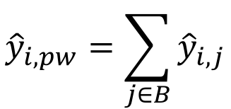
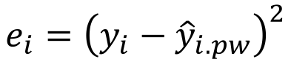
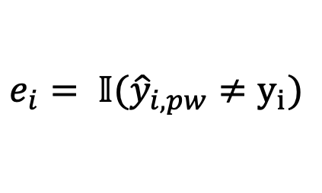
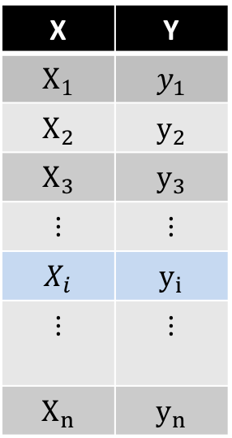
Point-wise out-of-bag error
B Trees that did not see $\{X_{i},y_{i}\}$
X | Y
$$X_{1}$$ | $$y_{1}$$
$$X_{2}$$ | $$y_{2}$$
$$X_{3}$$ | $$y_{3}$$
$$⋮$$ | $$⋮$$
$$X_{i}$$ | $$y_{i}$$
$$⋮$$ | $$⋮$$
$$X_{n}$$ | $$y_{n}$$
Classification
$${\hat{y}}_{i,pw}=majority({{\hat{y}}_{i})}$$
$$e_{i}= 𝕀({\hat{y}}_{i,pw}≠y_{i})$$
Regression
$${\hat{y}}_{i,pw}=\sum_{j∈B}{{\hat{y}}_{i,j}}$$
$$e_{i}={\left(y_{i}−{\hat{y}}_{i.pw}\right)}^{2}$$

Slide 45
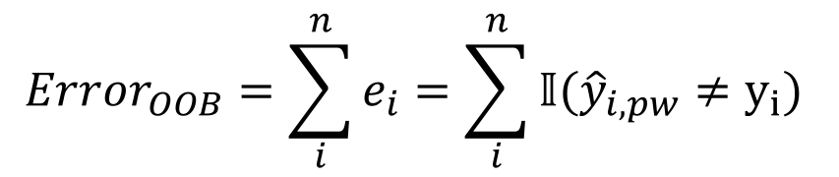
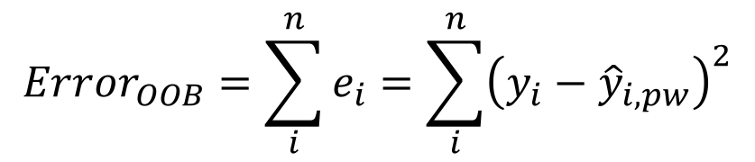
OOB Error
We average the point-wise out-of-bag error over the full training set.
Classification
$$Error_{OOB}=\sum_{i}^{n}{e_{i}}=\sum_{i}^{n}{𝕀({\hat{y}}_{i,pw}≠y_{i}) }$$
Regression
$$Error_{OOB}=\sum_{i}^{n}{e_{i}}=\sum_{i}^{n}{{\left(y_{i}−{\hat{y}}_{i,pw}\right)}^{2}}$$

Slide 46
Out-of-Bag Error
Bagging is an example of an ensemble method, a method of building a single model by training and aggregating multiple models.
With ensemble methods, we get a new metric for assessing the predictive performance of the model, the out-of-bag error.
Given a training set and an ensemble of models, each trained on a bootstrap sample, we compute the out-of-bag error of the averaged model by
For each point in the training set, we average the predicted output for this point over the models whose bootstrap training set excludes this point. We compute the error or squared error of this averaged prediction. Call this the point-wise out-of-bag error.
We average the point-wise out-of-bag error over the full training set.

Slide 47
Bagging
Question: Do you see any problems?
Still some overfitting if the trees are too large.
If trees are too shallow it can still underfits.
Interpretability:
The major drawback of bagging (and other ensemble methods that we will study) is that the averaged model is no longer easily interpretable - i.e. one can no longer trace the ‘logic’ of an output through a series of decisions based on predictor values!

Slide 48
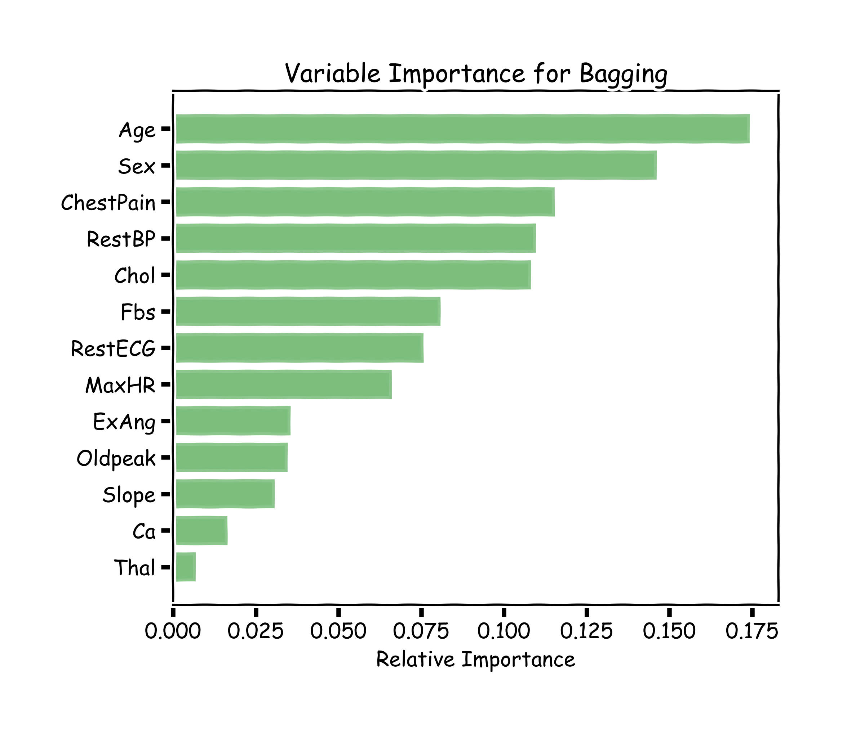
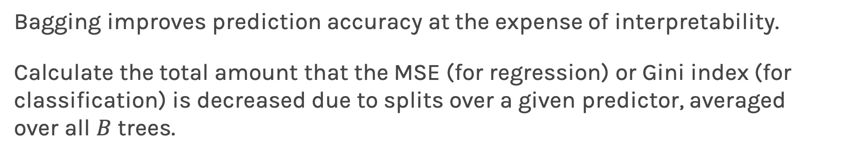
Variable Importance for Bagging
Bagging improves prediction accuracy at the expense of interpretability.
Calculate the total amount that the MSE (for regression) or Gini index (for classification) is decreased due to splits over a given predictor, averaged over all $B$ trees.
100 trees, max_depth=10

Slide 49
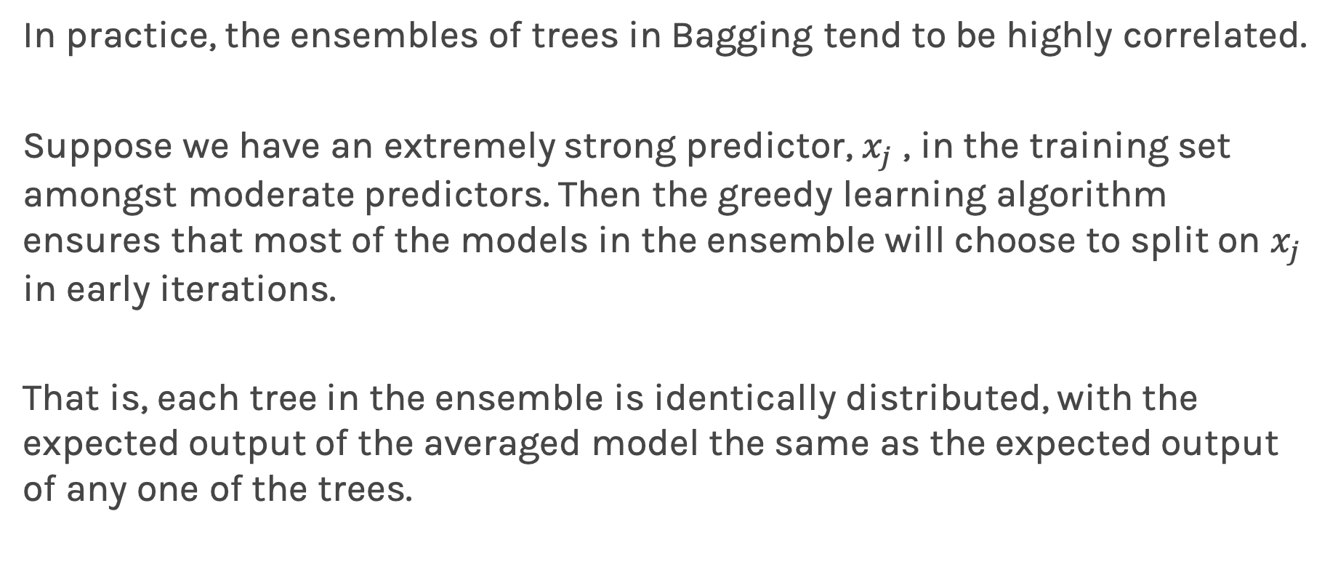
Improving on Bagging
In practice, the ensembles of trees in Bagging tend to be highly correlated.
Suppose we have an extremely strong predictor, $x_{j}$ , in the training set amongst moderate predictors. Then the greedy learning algorithm ensures that most of the models in the ensemble will choose to split on $x_{j}$ in early iterations.
That is, each tree in the ensemble is identically distributed, with the expected output of the averaged model the same as the expected output of any one of the trees.

Slide 50
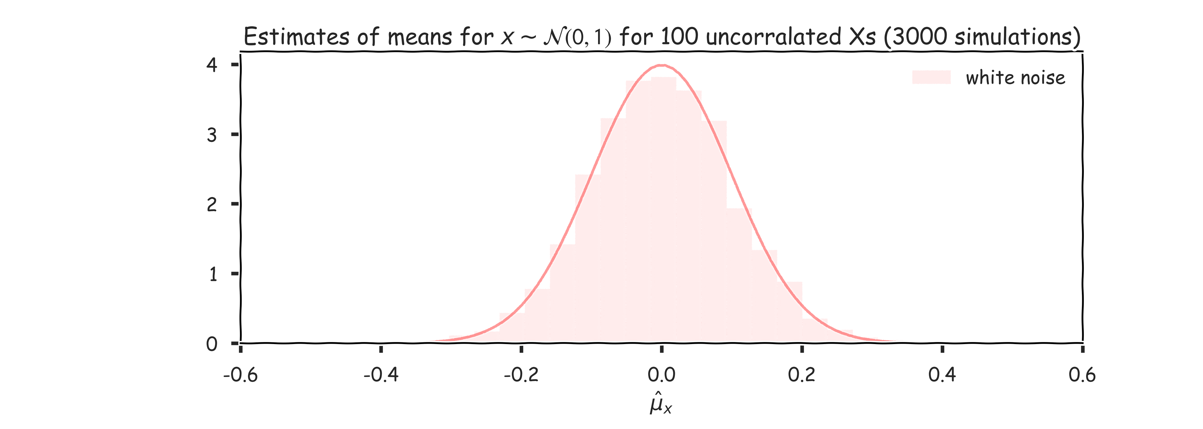
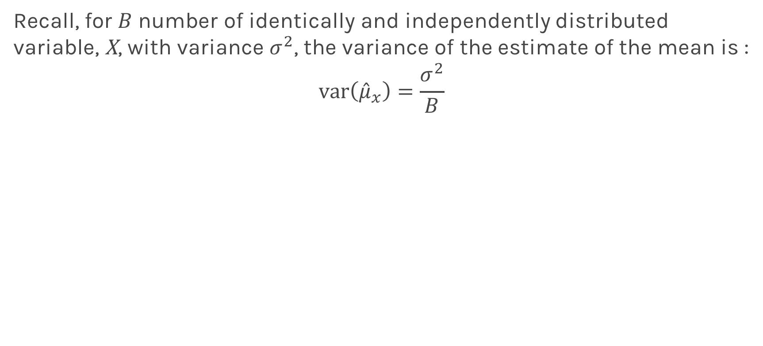
Improving on Bagging
Recall, for $B$ number of identically and independently distributed variable, X, with variance $σ^{2}$, the variance of the estimate of the mean is :
$$var\left({\hat{μ}}_{x}\right)=\frac{σ^{2}}{B}$$

Slide 51
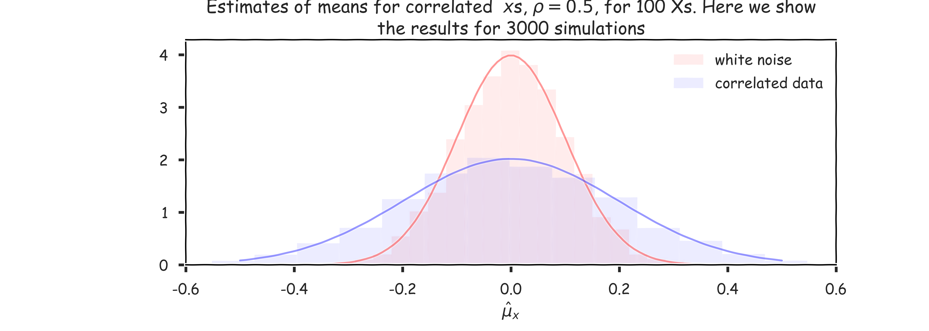
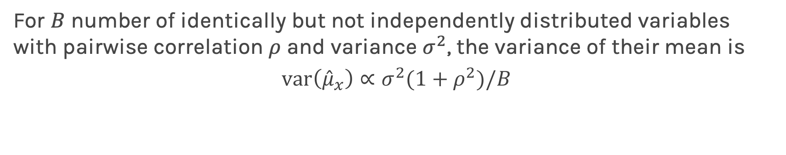
Improving on Bagging
For $B$ number of identically but not independently distributed variables with pairwise correlation $ρ$ and variance $σ^{2}$, the variance of their mean is
$$var\left({\hat{μ}}_{x}\right)∝σ^{2}(1+ρ^{2})/B$$

Slide 52
Bagging
Question: Do you see any problems?
Still some overfitting if the trees are too large
If trees are too shallow it can still underfits.
interpretability
The major drawback of bagging (and other ensemble methods that we will study) is that the averaged model is no longer easily interpretable - i.e. one can no longer trace the ‘logic’ of an output through a series of decisions based on predictor values!

Slide 53
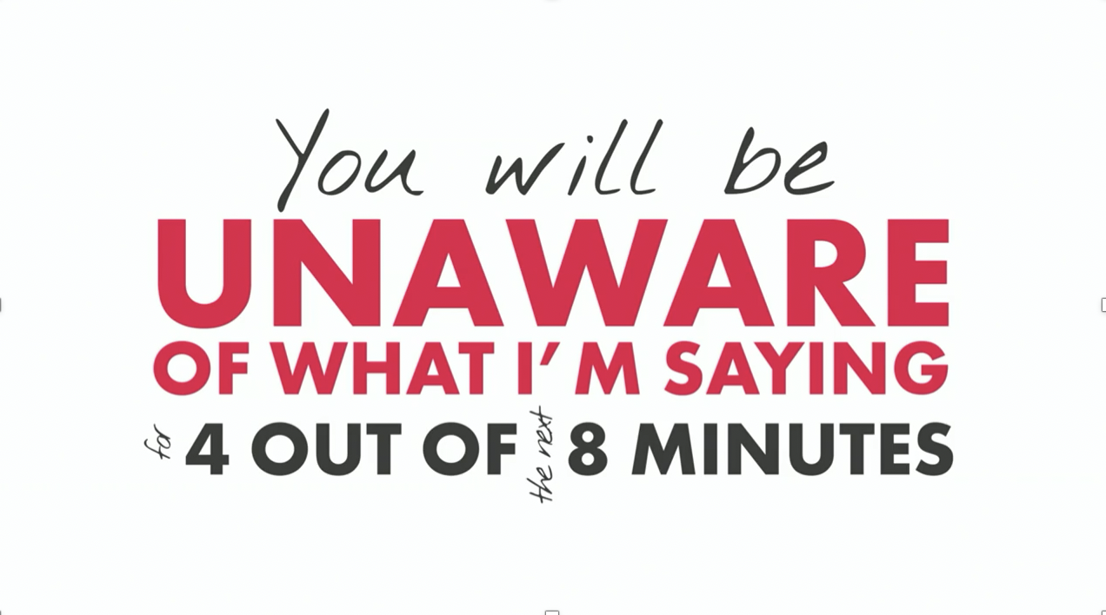
Zeenat Potia

Slide 54
Random Forests

Slide 55
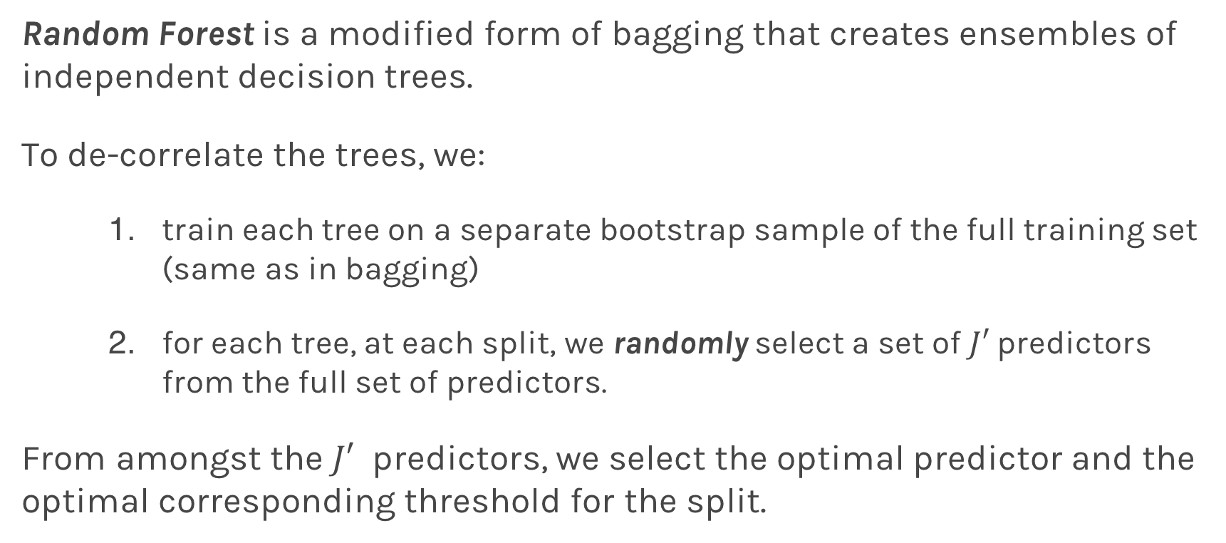
Random Forests
Random Forest is a modified form of bagging that creates ensembles of independent decision trees.
To de-correlate the trees, we:
train each tree on a separate bootstrap sample of the full training set (same as in bagging)
for each tree, at each split, we randomly select a set of $J′$ predictors from the full set of predictors.
From amongst the $J′$ predictors, we select the optimal predictor and the optimal corresponding threshold for the split.

Slide 56
Tuning Random Forests
Random forest models have multiple hyper-parameters to tune:
the number of predictors to randomly select at each split
the total number of trees in the ensemble
the minimum leaf node size
In theory, each tree in the random forest is full, but in practice this can be computationally expensive (and added redundancies in the model), thus, imposing a minimum node size is not unusual.

Slide 57
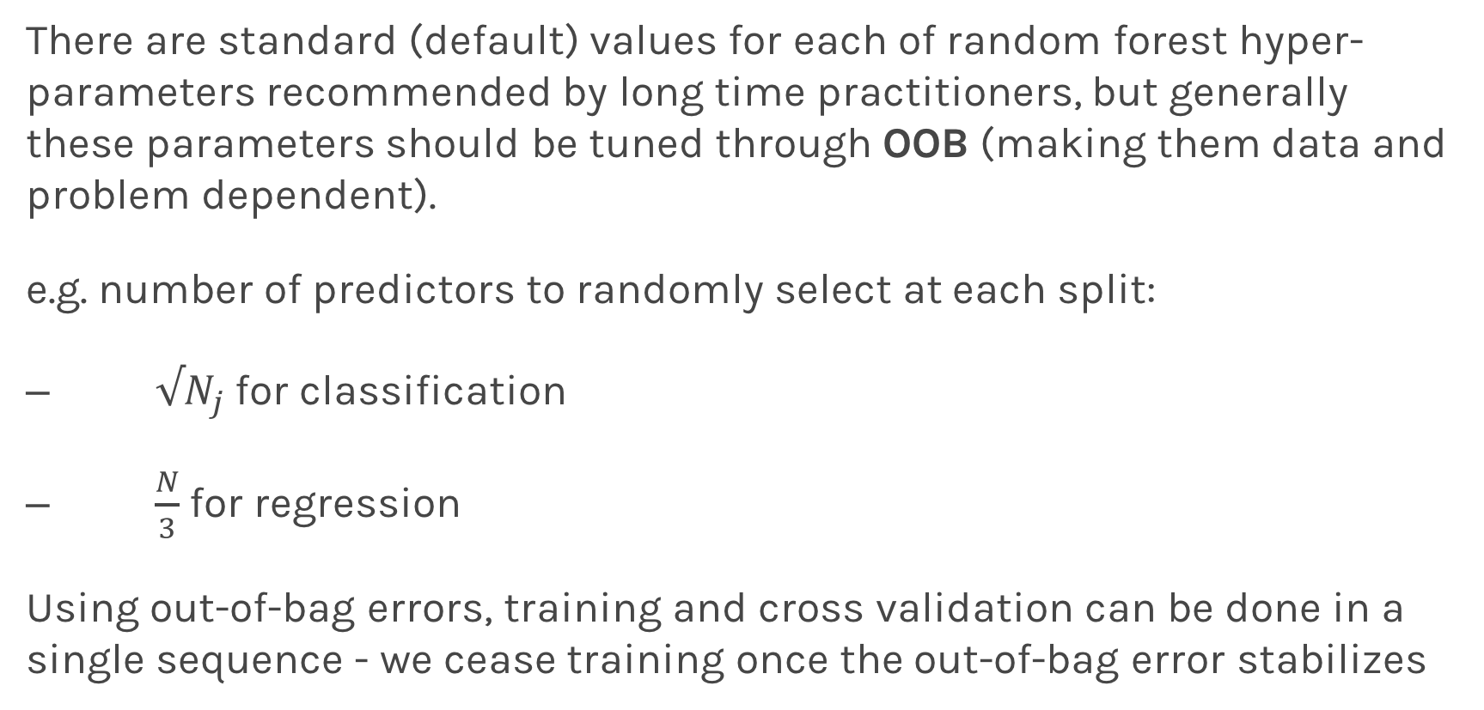
Tuning Random Forests
There are standard (default) values for each of random forest hyper-parameters recommended by long time practitioners, but generally these parameters should be tuned through OOB (making them data and problem dependent).
e.g. number of predictors to randomly select at each split:
$√N_{j}$ for classification
$\frac{N}{3}$ for regression
Using out-of-bag errors, training and cross validation can be done in a single sequence - we cease training once the out-of-bag error stabilizes

Slide 58
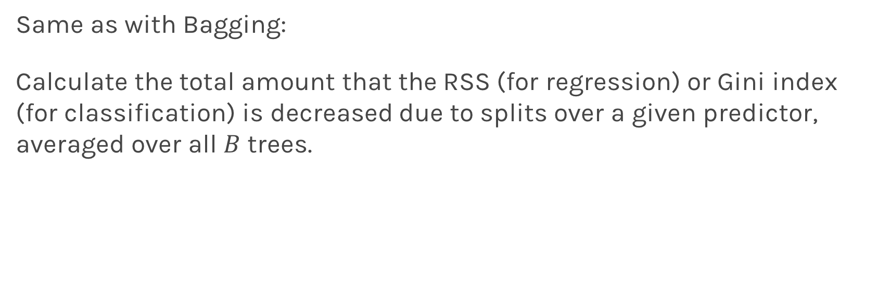
Variable Importance for RF
Same as with Bagging:
Calculate the total amount that the RSS (for regression) or Gini index (for classification) is decreased due to splits over a given predictor, averaged over all $B$ trees.

Slide 59
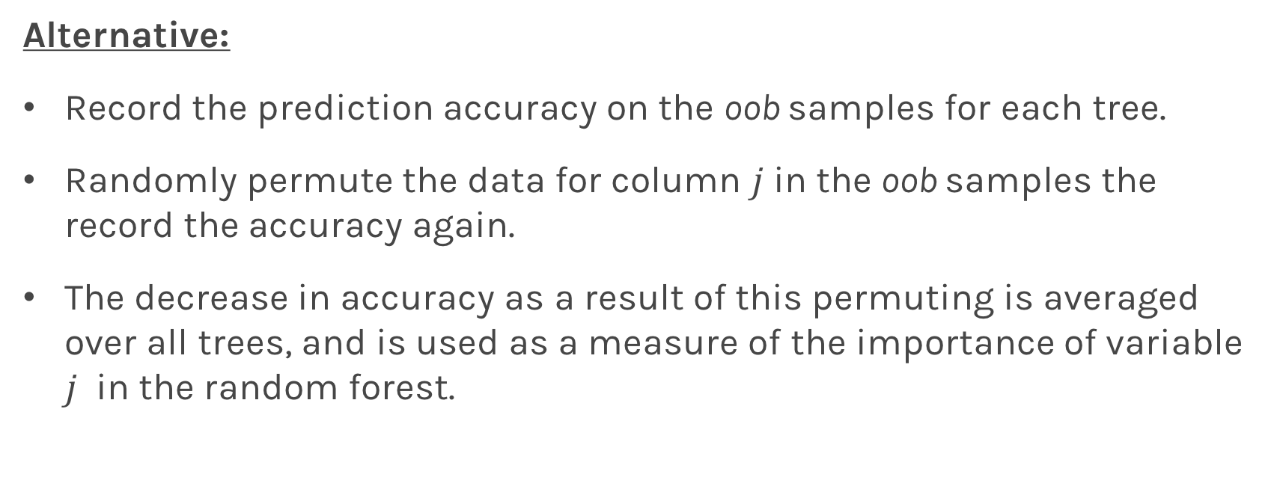
Variable Importance for RF
Alternative:
Record the prediction accuracy on the oob samples for each tree.
Randomly permute the data for column $j$in the oob samples the record the accuracy again.
The decrease in accuracy as a result of this permuting is averaged over all trees, and is used as a measure of the importance of variable $j$ in the random forest.

Slide 60
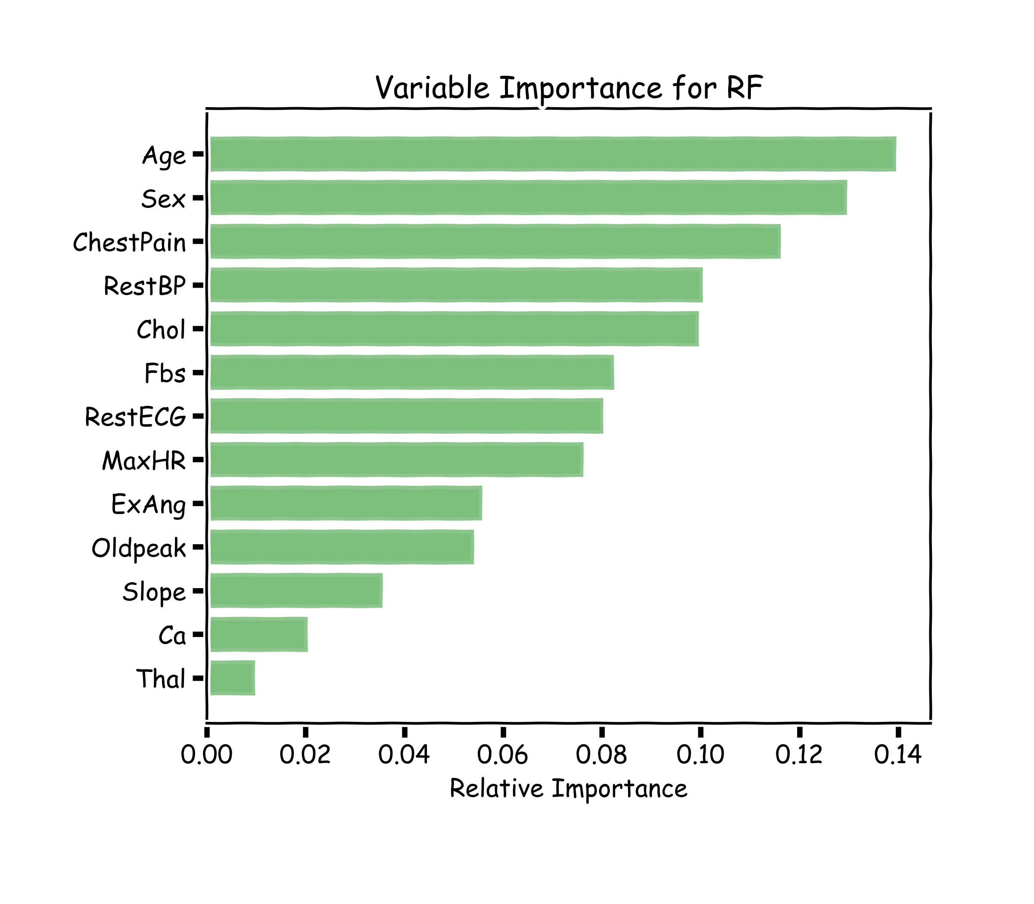
Variable Importance for RF
100 trees, max_depth=10

Slide 61
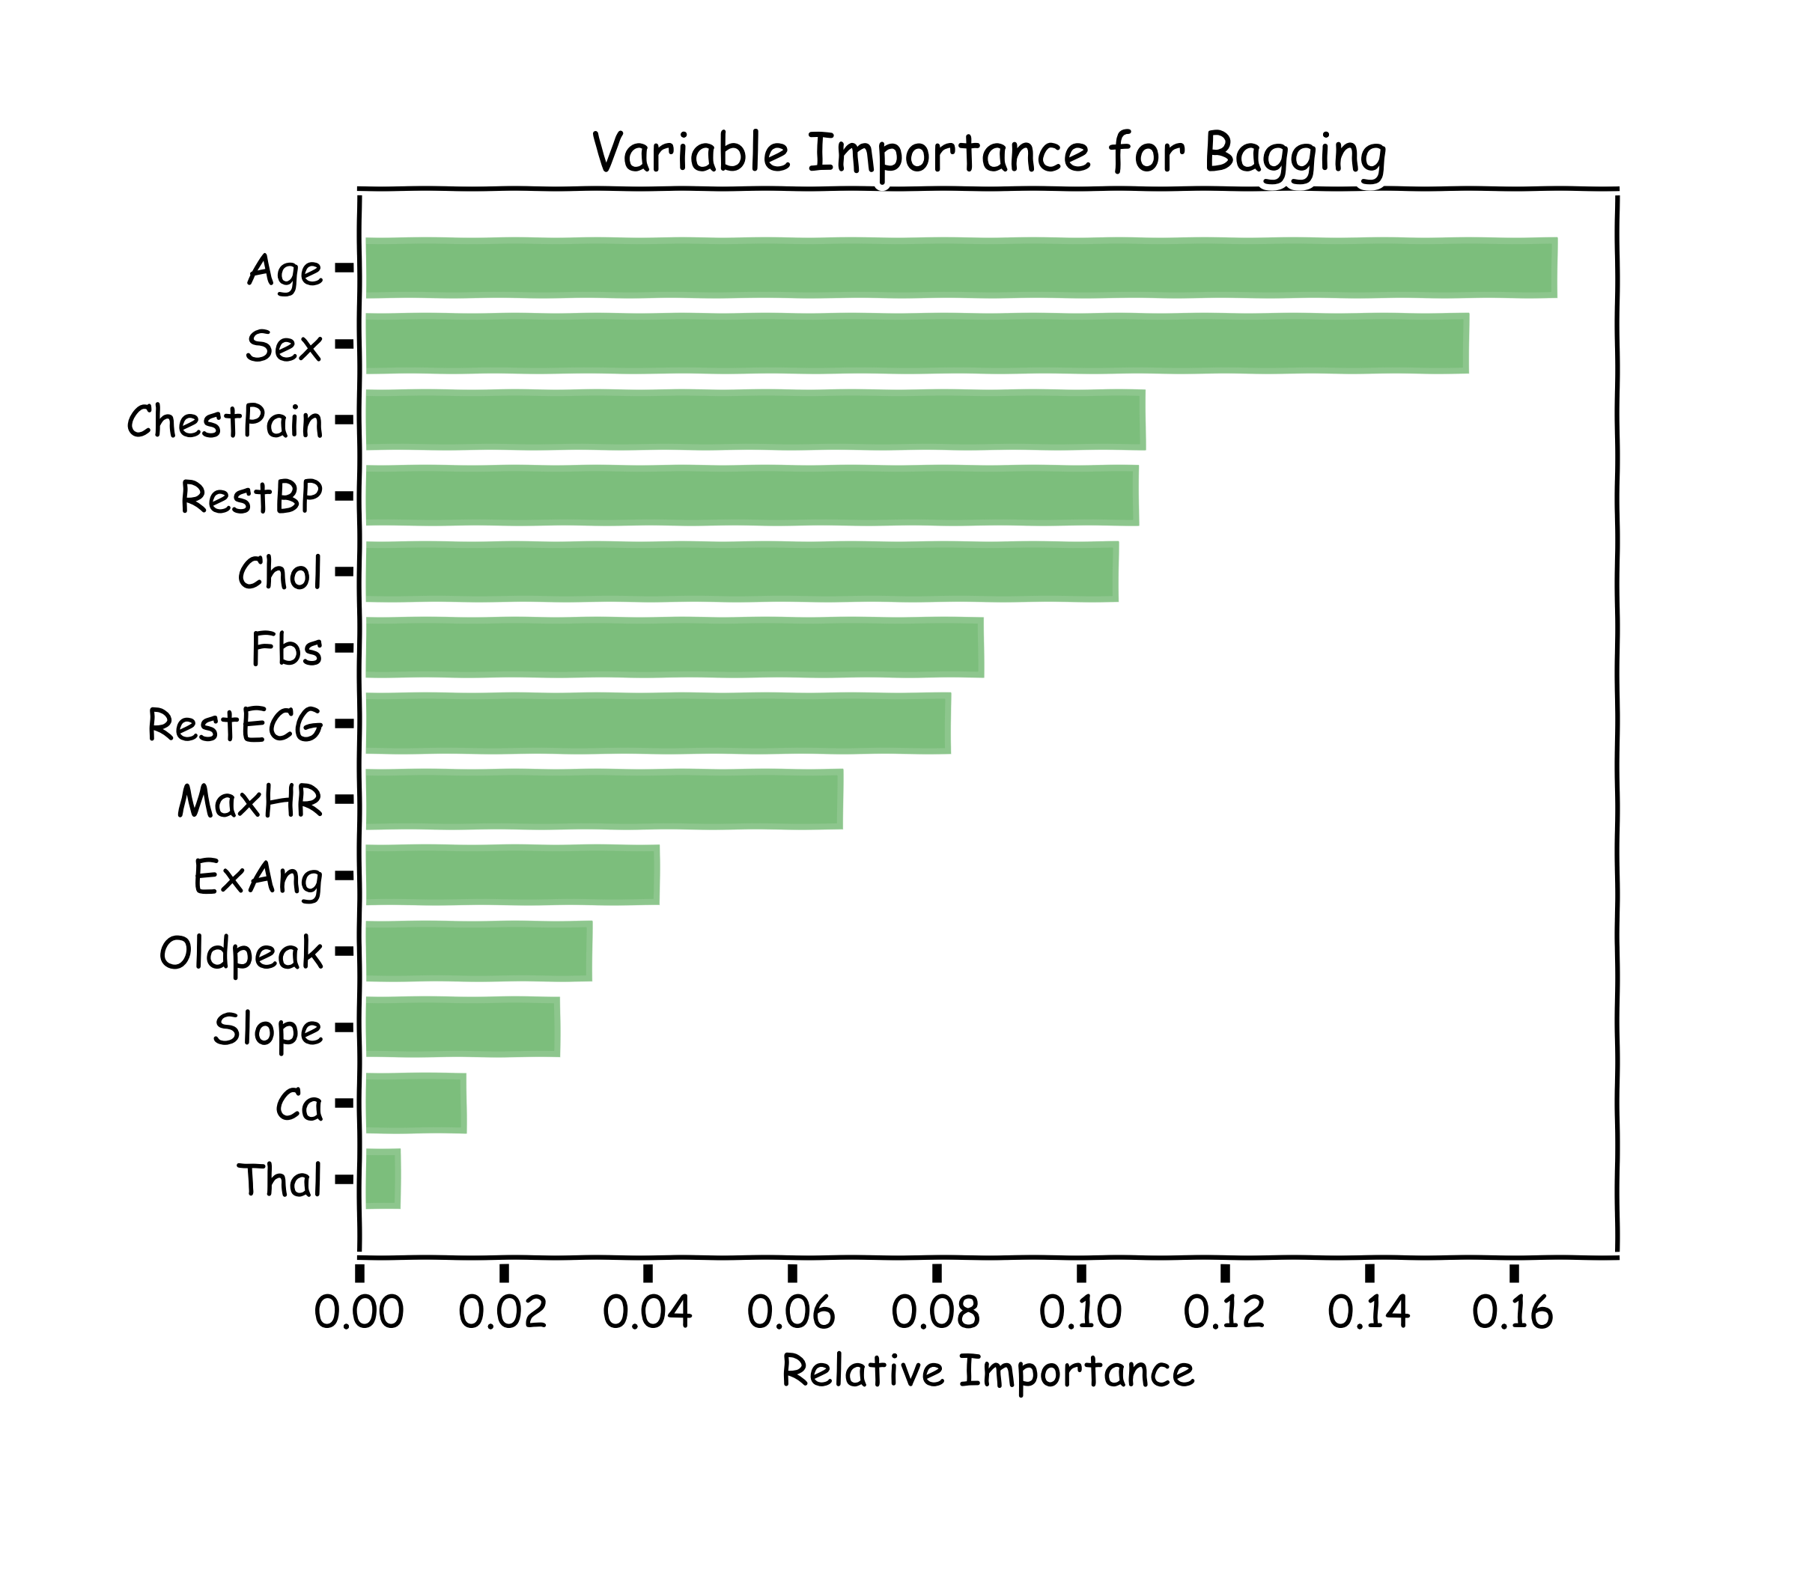
Variable Importance for RF
100 trees, max_depth=10

Slide 62
Final Thoughts on Random Forests
When the number of predictors is large, but the number of relevant predictors is small, random forests can perform poorly.
Question: Why?
In each split, the chances of selected a relevant predictor will be low and hence most trees in the ensemble will be weak models.

Slide 63
Final Thoughts on Random Forests (cont.)
Increasing the number of trees in the ensemble generally does not increase the risk of overfitting.
Again, by decomposing the generalization error in terms of bias and variance, we see that increasing the number of trees produces a model that is at least as robust as a single tree.
However, if the number of trees is too large, then the trees in the ensemble may become more correlated, increase the variance.

Slide 64
Final Thoughts on Random Forests (cont.)
Probabilities:
Random Forrest Classifier (and bagging) can return probabilities.
Question: How?

Slide 65
Next Lecture
Unbalance dataset
Weighted samples
Categorical data
Missing data
Different implementations
AND BOOSTING

